Slide 2
Git & CI/CD

Slide 3

Getting Started

Slide 4
GIT is a VCS but what is a VCS?
Veritas Cluster Server, a commercial high-availability computer clustering system
Version Control System, a system for managing multiple revisions
Venture CapitalS, specials investment funds
Vietnamese Council of State, the highest standing body of the National Assembly of Vietnam

Slide 5
When is GIT born?
1998, Hugo Chávez is elected President of Venezuela
2002, Salt Lake city winter olympic games
2005, Pope John Paul II dies
2008, Satoshi Nakamoto publish "Bitcoin: A Peer-to-Peer Electronic Cash System"

Slide 6
Who invented GIT?
Linus Torvalds, historical inventor of the linux kernel
Rod Johnson, programmer and Spring Framework creator
Larry Page, Google co-founder
Marie Curie, pioneer researcher in radioactivity, first woman to own a Noble Price and only person to win a Nobel Prize in two different sciences (Physics & chemistry)

Slide 7
What is git internal checksum algorithm?
None, no one needs to check file/system integrity
MD5, producing vulnerable 128-bit hash value, published in 1992
SHA-1, producing vulnerable 160-bit hash value, published in 1995
SHA-256, NSA secured 256-bit hash value, published in 2001

Slide 8
Why git?

Slide 9
Why git?
Before version control exists…
(╯ಠ_ಠ)╯彡┻━┻
With Git
Collaborative
Project versioning with immutable commits
(history of commits with date and user as well as changes)
Conflict resolutions

Slide 10
Basic notions

Slide 11
Basic notions
A working directory with the current version
Commit = unit of change
Snapshots not diffs!
.git folder contains all git metadata:
Snapshots (blob, tree…)
Commits
...

Slide 12
Basic notions - Commit Workflow
No changes since last commit
Clean Directory
code modification
Some unsaved changes, but git doesn’t care
Working Directory
git add
Still unsaved changes, but git DOES care
Staging Area
git commit
Changes saved
Clean Directory
Notes:
Analogie restaurant: clean: tout le monde dans le restaurant est servi dirty: de nouveaux clients arrivent, mais n’ont pas passé commande
staged: la commande est passée clean: la commande est servie.

Slide 13
Inspect git
Keep an eye open. And the good one!

Slide 14
Inspection command
Working directory changes details:
git diff
Staging area informations:
git status
Commit history:
git log
git log --graph --decorate --pretty=oneline --abbrev-commit --all

Slide 15
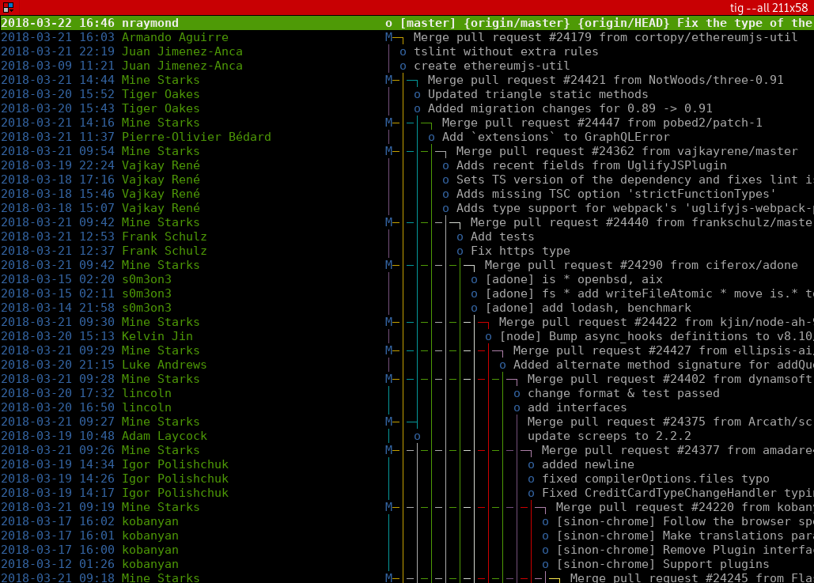
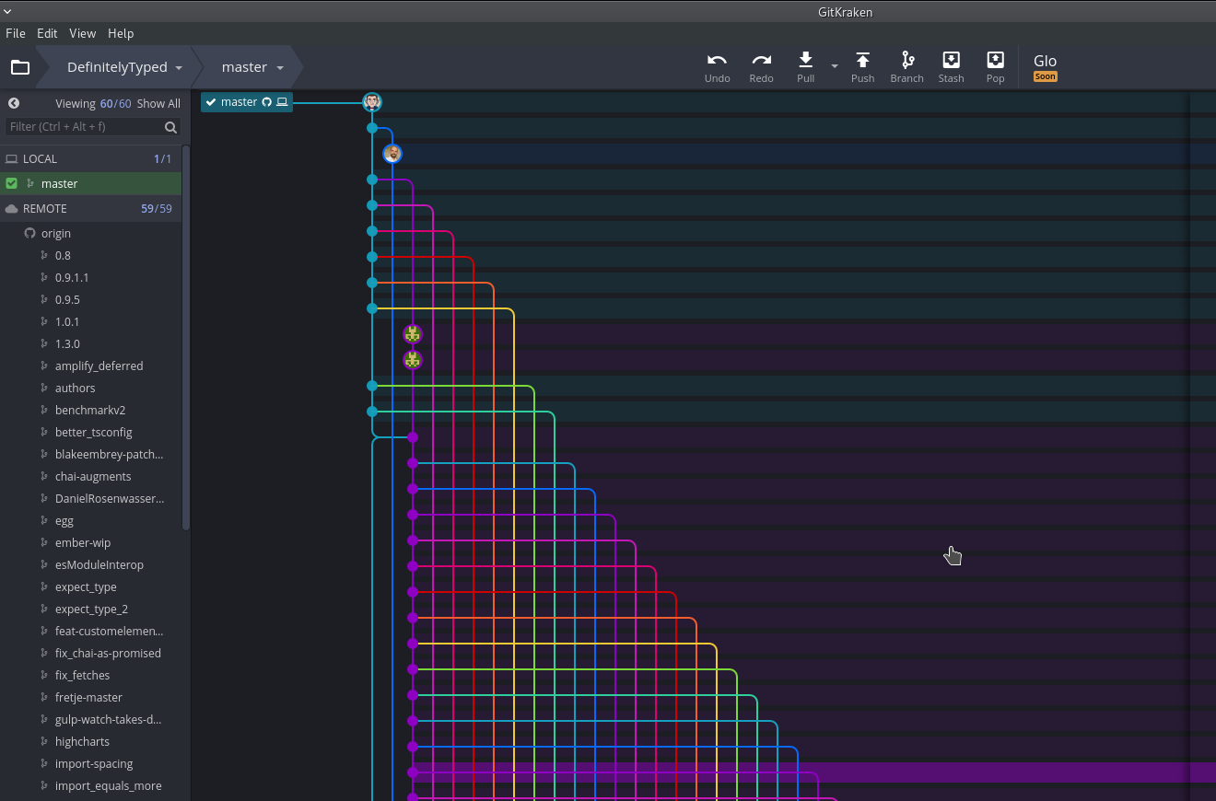
Useful tools
Textual interface for git: TIG
Graphical Interface for GIT:
GitKraken, gitk, gitg...

Slide 16
First Steps

Slide 17
First Steps: Authentify yourself
Command Line
⯈ git config --global user.name jdoe
⯈ git config --global user.email jdoe@takima.fr
Working Directory
my-project

Slide 18
First Steps: Init the repository
Command Line
⯈ cd my-project ⯈ git init ⯈ touch README.md
Working Directory
my-project ├── .git/ └── README.md

Slide 19
First Steps: Add README
Command Line
# Edit README.md
⯈ git add README.md
Working Directory
my-project ├── .git/ └── README.md ++

Slide 20
First Steps: Commit README
Command Line
Git log
⯈ git commit -m “Initial commit”
commit 170bbfdbf6215fd31dd0e9df1059e79393e7438d (HEAD -> master)
Author: John Doe <jdoe@takima.fr>
Date: Thu Jan 30 12:29:15 2020 +0100
Initial commit
Working Directory
my-project ├── .git/ └── README.md
Git tree
* 170bbfd (HEAD -> master) Initial commit
⯈ git config --global alias.tree
"log --graph --decorate --pretty=oneline --abbrev-commit --all --full-history"

Slide 21
First Steps: Ignore some files
Command Line
.gitignore
# Add and edit a .gitignore file and hello class: src/Hello.java
.idea/ *.svn .DS_Store .project .settings .classpath Thumbs.db bin target *~
Working Directory
my-project ├── .git/
├── README.md ├── .gitignore └── src/
Tip: generate tailor-made gitignore with https://www.gitignore.io/

Slide 22
First Steps: Find documentation
Command Line
⯈ git add --help
⯈ git add -A
Description
“This command updates the index using the current content found in the working tree ...“
Options
“-f, --force
Allow adding otherwise ignored files.
-i, --interactive
Add modified contents in the working tree interactively to the index...”
Configuration
“The optional configuration variable core.excludesFile indicates a path to a file containing patterns”
Example
“$ git add Documentation/\*.txt “
...
Working Directory
my-project ├── .git/
├── README.md ├── .gitignore ++ └── src/Hello.java ++

Slide 23
First Steps: Commit .gitignore
Command Line
Git tree
⯈ git commit -m “Add gitignore and Hello class”
* 2d1d505 (HEAD -> master) Add gitignore...
* 170bbfd Initial commit
Working Directory
my-project ├── .git/
├── README.md ├── .gitignore ++ └── src/Hello.java ++

Slide 24
First Steps: Git difference
Command Line
Git diff
# Implement hello world class: src/Hello.java ⯈ git diff
diff --git a/src/Hello.java b/src/Hello.java
index 9b4320d..30f1f79 100644
--- a/src/Hello.java
+++ b/src/Hello.java
@@ -1,3 +1,5 @@
public class Main {
-
+ public static void main(String... args) {
+ System.out.println("Hello World !");
+ }
}
Working Directory
my-project ├── .git/
├── README.md ├── .gitignore └── src
└── Hello.java
Tip: generate tailor-made gitignore with https://www.gitignore.io/

Slide 25
First Steps: Add and commit
Command Line
Git tree
⯈ git commit -am “Add hello world”
* 603117b (HEAD -> master) Add hello world
* 2d1d505 Add gitignore...
* 170bbfd Initial commit
Working Directory
my-project ├── .git/
├── README.md ├── .gitignore └── src
└── Hello.java

Slide 26
Play with branches

Slide 27
Branching notions: GoT s01e09
Head Attached...
Head Detached...
master
HEAD
master
HEAD

Slide 28
Branching notions: How to select a specific commit
Use a reference pointing on it (branch, tag, HEAD…)
Use the commit id
Use relative accessor with `ref~number`
`HEAD~2` means “2 commits before HEAD”
c5e824
HEAD
9f6cc8
HEAD~1 (or HEAD^)
2f999a
HEAD~2
85cc12
HEAD~3

Slide 29
Forking

Slide 30
Forking
Command Line
Git log
# We will reuse the last git log
# as an example...
HEAD
master
B
Working Directory
my-project ├── README.md └── src └── hello.java
A

Slide 31
Forking: Create a branch
Command Line
Git log
⯈ git branch feature
feature
B
Working Directory
HEAD
master
my-project ├── README.md └── src └── hello.java
A

Slide 32
Forking: Checkout out another branch
Command Line
Git log
⯈ git checkout feature
# or “git checkout -b feature” to also create the branch
HEAD
feature
B
Working Directory
master
my-project ├── README.md └── src └── hello.java
A
Tip: You can detach HEAD by doing git checkout <commit-id> fe

Slide 33
Forking: Create commits on a branch
Command Line
Git log
# Create feature.java file ⯈ git add src/feature.java ⯈ git commit -m ”1”
# Create 2 more commits...
HEAD
feature
3
2
Working Directory
1
my-project ├── README.md └── src ├── hello.java
└── feature.java
master
B
A

Slide 34
Forking: Checkout back master
Command Line
Git log
⯈ git checkout master
feature
3
2
Working Directory
1
my-project ├── README.md └── src └── hello.java
HEAD
master
B
A

Slide 35
Forking: Create commit on a branch
Command Line
Git log
# Create master.java file ⯈ git add src/master.java ⯈ git commit -m ”msgC”
# Create 1 more commit...
3
feature
HEAD
master
D
2
Working Directory
C
1
my-project ├── README.md └── src ├── hello.java
└── master.java
B
A

Slide 36
Merging
Merge feature into master by keeping the history

Slide 37
Merging (no fast-forward)
Command Line
Git log
# We start from our forked
# example
feature
HEAD
master
Working Directory
my-project ├── README.md └── src ├── hello.java
└── master.java

Slide 38
Merging
Command Line
Git log
⯈ git merge [no-ff] feature
Merge commit
HEAD
master
feature
Working Directory
my-project ├── README.md └── src ├── hello.java
├── feature.java
└── master.java

Slide 39
Merging (no fast-forward): Remove feature branch
Command Line
Git log
⯈ git branch -d feature
HEAD
master
Working Directory
my-project ├── README.md └── src ├── hello.java
├── feature.java
└── master.java

Slide 40
Rebasing
Replay the feature on top of master so that it is up to date

Slide 41
Rebasing
Command Line
Git log
# Let’s go back to our forked
# example
3
feature
HEAD
master
D
2
Working Directory
C
1
my-project ├── README.md └── src ├── hello.java
└── master.java
B
A

Slide 42
Rebasing: Checkout the feature branch
Command Line
Git log
⯈ git checkout feature
3
feature
HEAD
master
D
2
Working Directory
C
1
my-project ├── README.md └── src ├── hello.java
└── feature.java
B
A

Slide 43
Rebasing: Rebase feature on master
Command Line
Git log
⯈ git rebase master
3’
feature
HEAD
2’
1’
3
Not tracked anymore by a reference
Working Directory
master
D
2
my-project ├── README.md └── src ├── hello.java
├── feature.java
└── master.java
C
1
B
A

Slide 44
Rebasing
Command Line
Git log
# Untracked commits disappear...
3’
feature
HEAD
2’
1’
Working Directory
master
D
my-project ├── README.md └── src ├── hello.java
├── feature.java
└── master.java
C
B
A
Note: The commits will be reapplied one by one fe

Slide 45
Take away
Branches, and tags are labels on commits
HEAD represents the state of your working directory
git merge to merge two branches
--no-ff: forces to create a merge commit
--ff-only: forces to do a fast-forward (no merge commit) or fail if not possible
no option: tries to do a fast-forward and if not possible create a merge commit
git rebase to rewrite history of a branch on top of another one
git revert to create a commit that cancel another one
git cherry-pick to copy a commit on top of the current branch

Slide 46
Work with Remotes

Slide 47




Remotes notions
A repository by developer
A remote central repository to do the synchronization
git server
git client 1
git client 2
git client 3

Slide 48
Take Away
git fetch to fetch changes on remote
no args to fetch only the branch we are currently on
-pa --tags to fetch all changes on remote
git pull to pull teammate commits from remote
no args == git fetch + git merge the remote branch
-r / --rebase == git fetch + git rebase on the remote branch
git push to push your commits on remote
-u or --set-upstream-to=<branch> to automatically track remote branch
-f to force remote branch location (Caution: Commits will be lost)
--delete repository branch to remove a distant branch

Slide 49
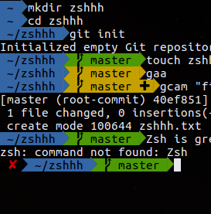
Tips and tricks
Use zsh with oh-my-zsh:
show current branch
show staging area state
auto-complete git commands
add some aliases
ggpush, ggpull, gf, gt…
Use Tig:
git drop-in replacement
tig --all: explore commit history
Use a graphical tool
eg: gitkraken
when commit trees become insane
most IDEs support git

Slide 50
CI/CD
DevOps workflows made easy

Slide 51
CI/CD ?
?
Notes:
What does CI and CD means ?
What is Continuous Integration ?
What is continuous Delivery/Deployment ?
Differences between CDelivery and CDeployment ?

Slide 52
Workflows: Your own workflow
There is no silver bullet
Try to adjust your workflow in function of:
Your team needs
Your project needs
Your budget (Number of available environments…)
Your CI/CD tools
...

Slide 53


Continuous integration/deployment
With Github
Travis CI
and SonarCloud

Slide 54
Before CI/CD...
Slow release cycles
Weekly or monthly…
Wasted hours
Conflicts on “merge day”
Bugfixes
Manual testing/deployment

Slide 55


CI/CD Pipeline
Continuous Integration (CI)
Regular integration => PR and merge
Automated build/tests
Continuous Delivery/Deployment (CD)
Release artefact on repository
Automatic deployment in production
Continuous
Integration
Continuous
Delivery
Continuous
Deployment
Commit
Build
Tests
Package
Deploy
Repository
Server
Notes:
“L’intégration continue est un ensemble de pratiques utilisées en génie logiciel consistant à vérifier à chaque modification de code source que le résultat des modifications ne produit pas de régression dans l’application développée. […] Le principal but de cette pratique est de détecter les problèmes d’intégration au plus tôt lors du développement. De plus, elle permet d’automatiser l’exécution des suites de tests et de voir l’évolution du développement du logiciel.”
“La livraison continue est une approche d’ingénierie logicielle dans laquelle les équipes produisent des logiciels dans des cycles courts, ce qui permet de le mettre à disposition à n’importe quel moment. Le but est de construire, tester et diffuser un logiciel plus rapidement. L’approche aide à réduire le coût, le temps et les risques associés à la livraison de changement en adoptant une approche plus incrémentale des modifications en production. Un processus simple et répétable de déploiement est un élément clé.”
from https://blog.eleven-labs.com/fr/introduction-gitlab-ci/ and wikipedia

Slide 56
Pros and Cons
?
Notes:
Des idées d’avantages ?

Slide 57
Pros and Cons
Frequent and easy releases
Constant feedback
Quick bug discovery
More time to focus on dev
Needs a DevOps mentality
Time of initial setup
Notes:
En résumé: On délivre du résultat plus sûr et plus vite

Slide 58
Tools
Travis CI
Jenkins
Gitlab CI
Circle CI
...
Notes:
Il existe beaucoup d’outils, Jenkins est très connu mais commencer à dater
Vous en connaissez d’autres ?

Slide 59
Intro to Github & Travis CI
Notes:
J’espère que vous avez compris l’intérêt d’un tel outil
Qui a déjà utilise GitLab CI/CD ?

Slide 60
Introduction
Github
Founded in 2008 - @Microsoft 2018
Git repository manager
Github Enterprise
Travis CI
Mostly open Source
(!) Not free for private repo
(!) Only for Github
Build matrix
Linux, macOS & Windows
Why not Bitbucket with Circle CI or Pipeline?
Or Gitlab with Jenkins?
Notes:
Il existe aussi un enterprise edition (payante) avec des features en plus
Gitlab propose beaucoup de feature (wiki, issue trackers, PR/review code, registre docker)
Gitlab a pour objectif de gérer l’ensemble du cycle devops sur une seule plateforme

Slide 61
Why Travis CI?
Full Github integration
Simple installation
Declarative configuration
Open source
Full Github integration
Some paid features
Not free for private repo
Notes:
Parler à l’oral des différences avec des outils populaire comme Jenkins
Jenkins -> Beaucoup de plugin créé par des développeurs qui peuvent conflictuer entrer eux / Gitlab -> open source : Chaque feature est merged dans le code principal et maintenu par les développeurs
Si vous avez déjà dû réinstaller Jenkins avec pleins de plugins vous savez que la configuration se fait presque entièrement par l’interface graphique...
Avantage:
Integration: registre docker, discussions, merge request pipeline...
simple install (runner) et simple config (un fichier)
Défaut: besoin de GitLab mais peux utiliser des repo externe avec le repository mirroring https://docs.gitlab.com/ee/ci/ci_cd_for_external_repos/
Feature premium: partage de script entre plusieurs projets, repository mirroring..

Slide 62
Travis CI

Slide 63



How it works
Dockerhub
4. Publish
1. Push
2. Trigger job
5. Deploy
3. Build
Developer
Github
Travis
Error: Alert
SonarCloud

Slide 64

How it works
phase - the steps of a job (install, script, deploy)
job - a process that clones your repository into a virtual environment and then carries out a series of phases.
build - a group of jobs.
stage - a group of jobs that run in parallel.

Slide 65

.travis.yml
language: java
cache:
directories:
- "$HOME/.m2/repository"
- "$HOME/.sonar/cache"
services:
- docker
before_install:
- docker pull postgres:9.6
- docker run -d -p 5432:5432 postgres
script:
- mvn clean install
notifications:
email:
on_failure: always
deploy:
provider: script
script: ssh -i /tmp/travis_deploy_rsa $USER@$SERVER" sudo docker pull $IMAGE_NAME:$TAG && sudo docker rm -f app || true && sudo docker run -d --network net -p 80:8080 --name app $IMAGE_NAME:$TAG"
on:
branch: master

Slide 66
SonarCloud

Slide 67
Technical debt
Deadline
Total
Tech
Debt
Unmanaged
Managed
Time

Slide 68
SonarCloud: quality
Quality analysis
20+ different languages
Test coverage & execution
Bug checking & code smells
And more

Slide 69

Take away :
CI/CD automates everything from commit to delivery
Gitlab CI/CD is a good option
Use Docker executor for isolation
Build matrix
Do not put sensitive data inside travis.yml
Use a quality gate

Slide 70
References
https://git-scm.com/docs
https://docs.travis-ci.com/
https://sonarcloud.io/documentation

